Slide 1
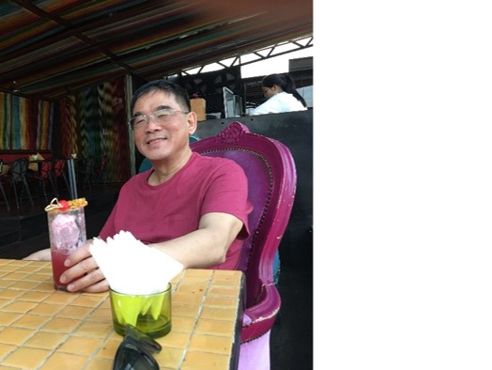
Database Lab 11 Advanced SQL Triggers Addendum
Dr. Jefferson Fong

Slide 2
Sign up for presentation time
Presentations will be held on Thu Dec 12, Sun Dec 15, Mon Dec 16.
Team leader sign up for time slots in during lab today.
Sign up in WeChat, starts when the teacher say so.
First come, first serve.
Data and Time | Team
Thu 12 Dec, 3-3:50 (4 teams)
Sun 15 Dec, 9:30-10:20 (4 teams)
Mon 16 Dec, 10:00-11:50 (8 teams)
Mon 16 Dec, 11:55-12:20 (2 teams)

Slide 3
Slide 3
Last lab, we’ve learned CHECK (e.g. GPA must be from 0 to 4) for one table.
For complicated predicate across multiple tables, we use TRIGGER.
Slide 7
When delete the p_code from program, we also must delete p_code from student.
Last lab’s way (top) versus using trigger (bottom).

Slide 4
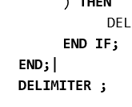
Slide 9
Run the example.
In the last line, there must be a space between DELIMITER and ;
Slide 10
Exercise 1, mimic the example in Slide 9.
Exercise 3, from the uic.sql database,
Schema for enroll(id, c_name, s_number, sem, grade)
Schema for course(c_name, credit, domain, c_number)
Need enroll JOIN course USING (c_name)

Slide 5


Slide 6
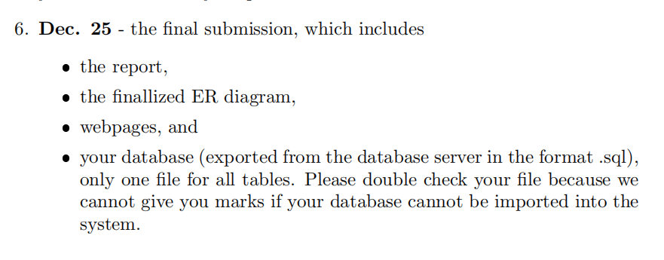
Reminder 2023, To be changed
Assignment 3 due Sunday 17 Dec
See Lab 12 Addendum v2 (in iSpace) for important info on the presentations.
Correction: put updated ER diagram in the Report, not the write-up.
From Project Requirement in iSpace

